Slide 1

Escaping Containment:
A Security Analysis of FreeBSD Jails
Michael Smith <michael@smith.eu> Ilja van Sprundel <ivansprundel@ioactive.com>
Notes:
Asked chatgpt to come up with some possible titles: 🧠 Serious / Academic
"Breaking Out of FreeBSD Jails: An Analysis of Kernel Exposure and Escape Vectors"
"Escaping Containment: A Security Evaluation of FreeBSD Jails"
"Jailed No More: Investigating Kernel Attack Surfaces in FreeBSD"
"Assessing the Security Boundaries of FreeBSD Jails"
"From Isolation to Exploitation: A Study of FreeBSD Jail Escapes"
🔍 Technical but Punchy
"Keys to the Jail: Escaping FreeBSD Confinement"
"Bars, Locks, and syscalls: The Road to a FreeBSD Jailbreak"
"Breaking Bars: Kernel-Level Escape Paths in FreeBSD"
"Unjailing FreeBSD: Finding Freedom Through Kernel Bugs"
"Chasing Jailbreaks: Exploring the Edges of FreeBSD Isolation"
😈 Playful / Creative
"Get Out of Jail FreeBSD Card"
"The Great FreeBSD Escape"
"Prison Break: FreeBSD Edition"
"Shawshank.syscall: Escaping the FreeBSD Jail"
"Escape Plan: FreeBSD"
"Rooted and Booted: Escaping the FreeBSD Jail"
🧩 Subtle / Metaphorical
"Bars Made of Code: Escaping FreeBSD’s Virtual Prisons"
"Freedom Behind Bars: A Deep Dive into FreeBSD Jails"
"When Isolation Fails: The Fragile Walls of a FreeBSD Jail"
"Breaking the Barrier: Weak Points in FreeBSD Jail Isolation"
"The Thin Wall Between Userland and Kernel: FreeBSD Jail Security"

Slide 2
Who?
Ilja van Sprundel
Sr. Director Of Operating System Security @IOActive
Been going to every CCC congress since 18c3
Spoken a number of them on various topics
Fuzzing
Code review and finding bugs
Linux
BSD
Windows
Michael Smith
Independent Programmer and System Administrator
First time at CCC 21c3 (2004), second time 21 years later: 39c3, both with Ilja!
Computers: hobby ≈ work
OS agnostic, programming language agnostic

Slide 3
Audience?
Security geeks
Security Auditors & Code Reviewers
Operating System Security Researchers
Defensive Security Engineers / Blue Teams
Offensive Security Professionals
FreeBSD folks
Container & Virtualization people
OS nerds

Slide 4
About?
A technical deep dive into the security boundaries of FreeBSD jails
Focused on escape techniques, attack surfaces, and hardening lessons

Slide 5
Agenda
Intro stuff
Issues / bugs and exploits
Observations, conclusion & call to action

Slide 6
Many thanks to the FreeBSD security team
Ed Maste
Mark Johnston
Dag-Erling Smørgrav
Gordon Tetlow
Philip Paeps
Kristof Provost
…

Slide 7
Standing on the shoulders of giants
Esa Etelavuori
Sinan “noir” Eren
Silvio Cesare
Joel Eriksson
Claes Nyberg
Christer Öberg
Przemysław Frasunek
argp
Neil Kettle
K3
M00nbsd
CTurt
ChatGPT (When it’s not making stuff up :))
…

Slide 8
Intro / why?
Been wondering about the security of FreeBSD jails for ~25 years or so
Ever since they came out
Finally found some time to look into this earlier this year
Michael was doing some FreeBSD security / sysadmin work this year
We started talking about FreeBSD jails and security
Started collaborating on research a couple of days later

Slide 9
Assumptions
Assume a compromised jail
Can a jailed root escape the jail and get access to the host?
What are the risks?

Slide 10
History
Introduced in FreeBSD 4.0
Early 2000
Run normal unix things
On a single machine
With stronger isolation than chroot()
Matured and hardened over time
More and more subsystems and drivers were made jail aware
This all introduced potential attack surface
Examples
VNETs introduced in FreeBSD 7-8
Networking was limited before that
Flexible, dynamic config files
Better tooling to manage jails

Slide 11
How do jails work
Interesting side-node for jail_attach()
Can think of it as execve() from a set-user-id binary
Resources owned by that process are inherited (and accessible by the child (e.g., file descriptors)
Attaching / injecting into a jail needs to be done with care!
Config
jail.conf / jail_set()
Defines
Root fs
Hostname
IP/VNET
Mounts
Limits
Exposed devices
Creation
jail_attach()
Creates prison struct
Enforces chroot, fs access and mount namespaces
Process and credential tagging
ucred->cr_prison

Slide 12
How do jails work (2)
Syscall mediation
Enforces privilege restrictions
root in jail ≠ host root
No module loading (duh!)
prison_priv_check() (called by priv_check_cred())
Jail policy restricts privileges to enforce root in jail is not host root
Policy enforced jails can only ever use jail aware drivers / subsystems
Gives us a great starting point to audit
Config is still honored
Just because something is jail aware, doesn’t mean a jail can access it.

Slide 13
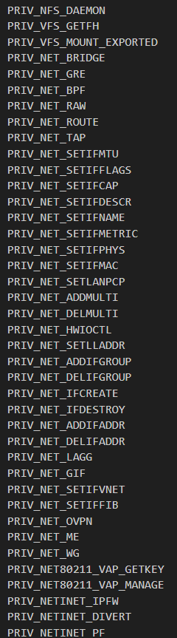
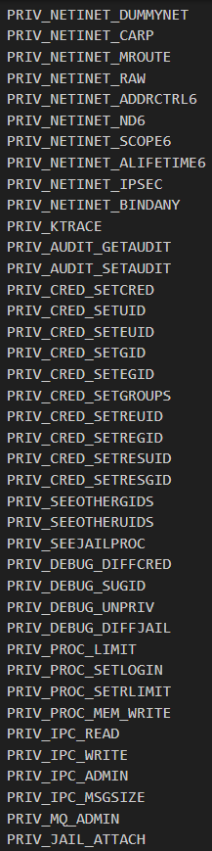
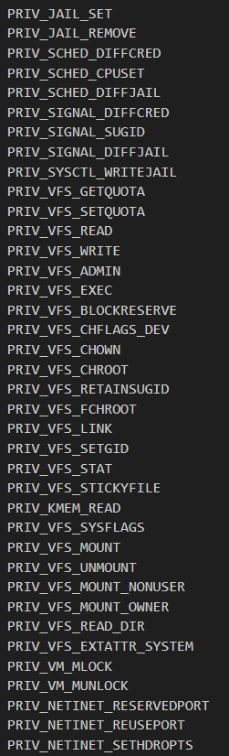
Allowed privileges in prison_priv_check()

Slide 14
Privileges
Lots of potential privileges that are allowed by policy
This is where our audit process started
Looked for callers of these specific privileges
Big interesting surface areas included
Lots of networking stuff
IPFW
IPFilter
Pf
Altq
If_ioctls
802.11
NFS
IPSec
Credential stuff
Process stuff
Sched
Signal
VFS
Kmem read!!
Linux subsystem

Slide 15
Audit process
Never completed looking at _ALL_ code that is reachable from jailed root
Took a pretty good stab at the networking stuff
Focused on handlers that are usually not accessible on the host as non-root
Thinking was:
Code written with only root callers in mind might be lax in terms of security
“Only root can use this anyway”
A lot of that code dates back to the 90s
Older code tends to have more trivial security bugs

Slide 16
Findings
> 40 issues found
Not all are fixed yet.
Will cover those that are fixed in more detail in a couple of slides
In several subsystems, including:
Ipsec
Carp
802.11
If_ioctls
Nfs
pf
IPFilter
IPFW

Slide 17
Process
GitHub for tracking
Issues found
Put in GitHub. Tag it.
Notes
Of attack surface we found along the way
Documentation
Dev / test setup
Exploit dev
Sharing findings with FreeBSD security team
Got realtime feedback from FreeBSD folks on issues
Helped weed out some duds
Got interesting insights into some of the code
GitHub repo is currently private
We want to open it
Not all bugs fixed yet
Public mirror with fixed bugs
https://github.com/iljavs/FreeBSD-Jail-Security-Research-Mirror
Will open up the full original one
When all bugs are fixed

Slide 18
Sampling of issues found

Slide 19
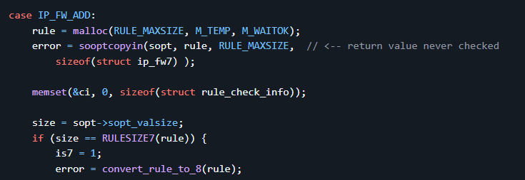
Unchecked return value of sooptcopyin() in IP_FW_ADD leads to use of uninitialized kernel data
malloc()
Copyin rule data from user to kernel to malloc()’ed memory
Return value not checked. Copyin can fail
Will leave data uninitialized
Will now operate on uninitialized kernel memory
Could leak information about uninitialized data

Slide 20
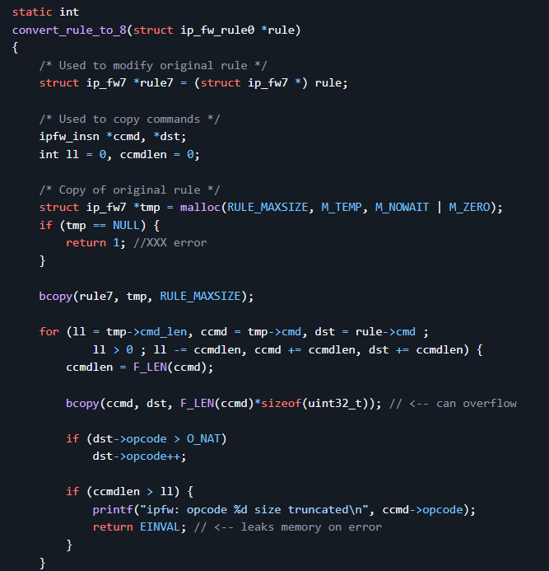
Buffer Overflow and Memory Leak in convert_rule_to_8()
convert_rule_to_8() is appcompat function
IPFW rule format changed from 7 to 8
This function converts it
Embedded length field not validated
Copied to dest buffer
Can corrupt memory
Also doesn’t release memory on error

Slide 21
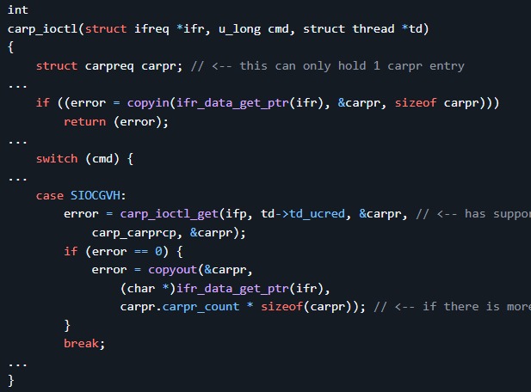
SIOCGVH (carp_ioctl_get) Copyout Size Mismatch
SIOCGVH
Can specify the number of carp records you want
Calls carp_ioctl_get() gets the records
Copied to carpr stack buffer
Stack buffer can only hold 1 entry !!!1!
This smells broken!
What does carp_ioctl_get() do???
It looks like it copies out the number of requested records
How does this ever work?

Slide 22
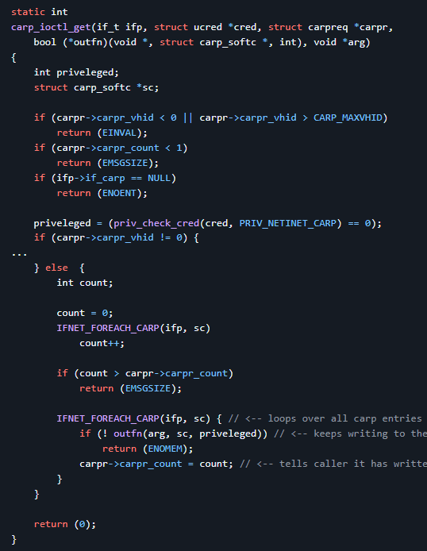
SIOCGVH (carp_ioctl_get) Copyout Size Mismatch
carp_ioctl_get() will loop over all the entries
_BUT_ it only copies to the first entry
Overwriting the previous entry
So no memory corruption
But still copies count amount of records to user!!
Copies out of bound!
By number of records there are
Jail admin can create as many records as he wants
Can reliably be used to leak out the stack cookie!

Slide 23
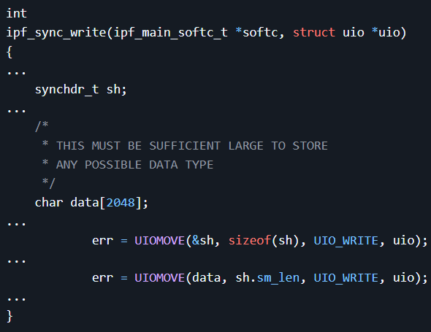
Stack Buffer Overflow in ipf_sync_write() (ip_sync.c)
write() handler
Ipfilter sync dvice
Reads struct from user land
Struct contains length field
No validation of length field whatsoever
Copies that many bytes from userland int oa 2048 byte stack buffer
Classic stack smash!!

Slide 24
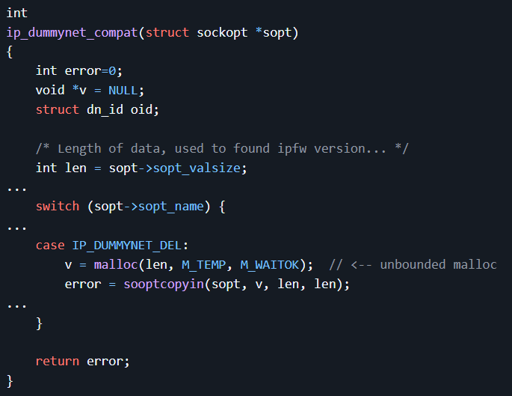
Unbounded malloc() in ip_dummynet_compat()
User controlled length value
Passed directly to malloc()
Generally a bad idea
BSDs kernel malloc’s are all wired
No paging!
Historically if length > defined MAX
panic
This is now dynamically defined in FreeBSD
But principle still hold
Arbitrary length passed to malloc
Will cause a panic

Slide 25
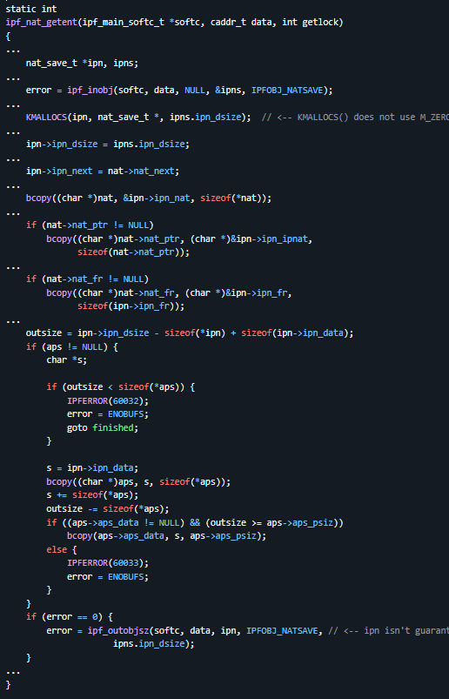
Information Disclosure in ipf_nat_getent() due to uninitialized heap memory being copied to userland
KMALLOCS() is malloc() wrapper
Size of elements and number of elements
M_ZERO not specified in caller
Returned memory is uninitialized
ipf_outobjsz()
Doesn’t fully initialize the entire memory that was allocated
Gets copied to userland
Including uninitialized kernel heap memory!
Could contain
Buffer cache data
Network buffers
E.g., unix domain socket data from ssh
Contains passwords
Tty buffers

Slide 26
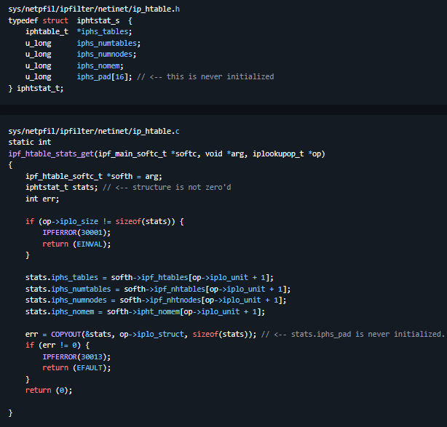
Information Leak in ipf_htable_stats_get() via Uninitialized Stack Padding (iphs_pad)
Iphtstat_s struct
Contains 16 pad bytes
Declared on the stack
Pad bytes never initialized
Entire struct copied to userland
COPYOUT()
Pad bytes contains uniitialized stack data
E.g., stack cookie

Slide 27
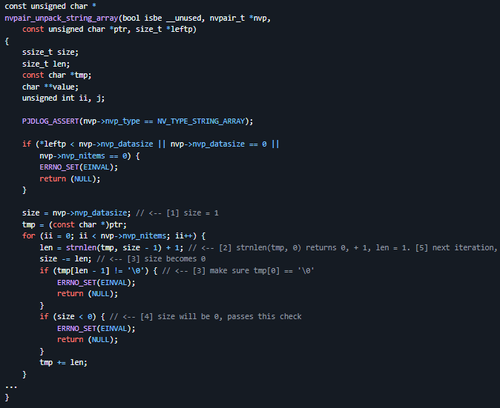
Integer Underflow in nvpair_unpack_string_array() Allows Out-of-Bounds Read
Libnv
Packed name value pairs
Used in various places in kernel and user
Including pf
Unpacking a string array
After Nth iteration
If size is exactly 0
Step 5
strnlen(tmp, -1)
This can read out of bound
And possibly panic
This code had recently been audited

Slide 28
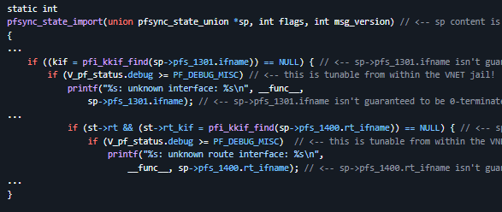
Out-of-Bounds Read and Info Leak in pfsync_state_import() via Unterminated Interface Names
ifname isn’t guaranteed to be 0-terminated
Passed to printf()
Referenced with %s
Expected 0-terminated string
Will just print until it sees a 0-byte
Trivial information leak
Directly prints data after string
Due to missing 0-terminator
Could also run out of bound and panic

Slide 29
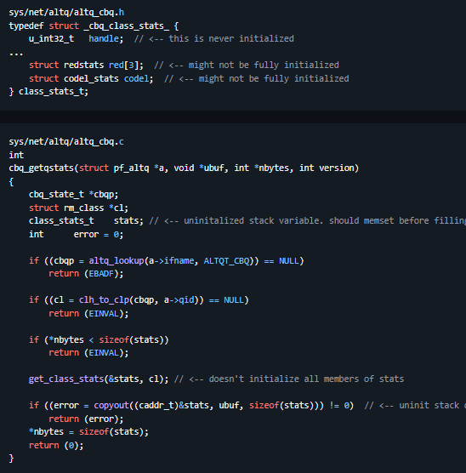
Information Disclosure in cbq_getqstats(), priq_getqstats(), and fairq_getqstats() via Uninitialized Stack Structures
_cbq_class_stats_ struct
Contains elements that might not get initialized
cbq_getstats()
Declares struct on the stack
Doesn’t initialize all elements
handle
red[3]
Codel
Copies stack struct to userland
Leaks uninitialized stack data
Info leak
E.g. could contain stack cookie

Slide 30
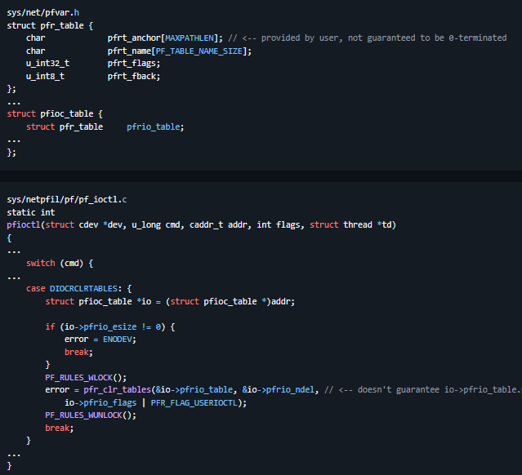
Out-of-Bounds Read/Write in pfr_clr_tables() via Missing NUL Termination for DIOCRCLRTABLES
pfr_table struct
Anchor char array
Will be provided from userland
No guarantee it is 0-terminated
pfioctl
Ioctl interface for pf packet filter
DIOCRCLRTABLES case
Calls pfr_clr_tables()
With table that contains anchor
Anchor not guaranteed to be 0-terminated

Slide 31
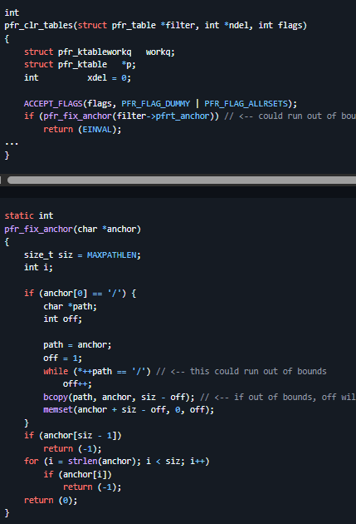
Out-of-Bounds Read/Write in pfr_clr_tables() via Missing NUL Termination for DIOCRCLRTABLES
pfr_clr_tables
Does anchor fix-up!
Pfr_fix_anchor
Scans over anchor string
Till not ‘/’
This could run out of bound!
Copy data after it to start
Using size - offset
This can overflow due to missing 0-terminator
Will corrupt memory!

Slide 32
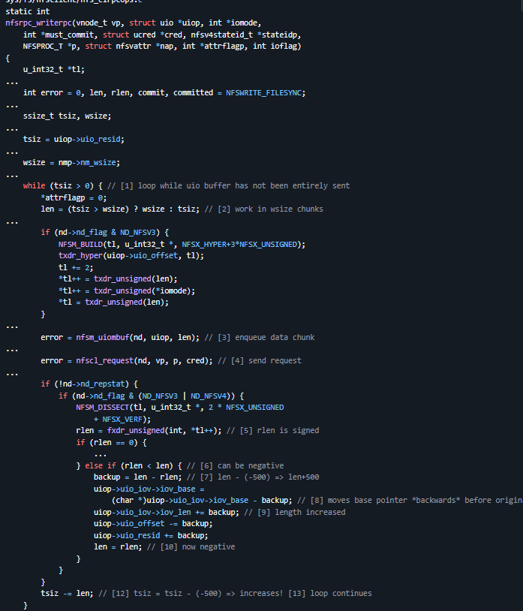
Remote Kernel Memory Disclosure in nfsrpc_writerpc() due to Signedness Issue
Nfs write rpc function
In nfs client
Writes data to server
In chunks
In a loop
Server will respond to the request
“This is how many bytes you actually wrote”
NFS spec says this value is unsigned int
Extracted with fxdr_unsigned()
Stored in a signed int! (rlen)
rlen has a bounds check
But only upper bounds
No negative check
Server can force client to write data
To server
Before the start of the data buffer
Remote Kernel Memory Disclosure
Up to 2 gigabytes of data
Can do 1 byte at a time

Slide 33
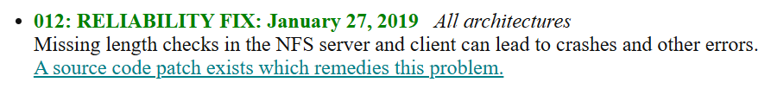
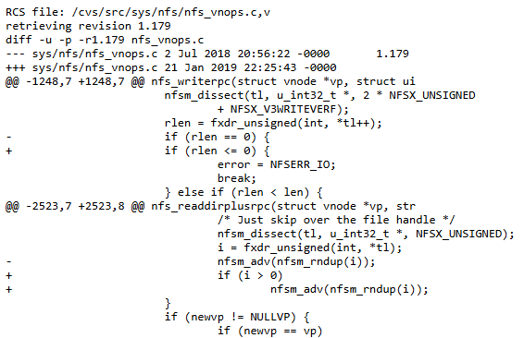
Remote Kernel Memory Disclosure in nfsrpc_writerpc() due to Signedness Issue
We found this early september (2025)
OpenBSD found and fixed it in 2019
But called it a reliability fix!
Talks about a crash
Did they realize it could leak uninitialized memory over the network?
Didn’t tell anyone else
NFS is a shared codebase
Came from sun
Still in solaris
In illumos
In FreeBSD
In NetBSD

Slide 34
Notes on bugs
Many of the more juicy bugs (EoP) haven’t been fixed yet
Integer overflows
Buffer overflows
Race conditions
Found some other bugs in FreeBSD code not really related to jails
ELF
exec
netmap

Slide 35
Exploits !!1?!

Slide 36
Proof of concept exploits
Identify good bug candidates
Estimate potential reach:
Trigger a denial of service
Disclosure of sensitive information
Complete host system compromise
Set up a solid exploit development environment

Slide 37
Exploit development environment
Solid development environment == setup for success
Tools
QEMU
Excellent VM / emulator
Cross platform compatibility (macOS, PC, decent x86-64 emulation on Apple Silicon)
Easy to juggle with disk images
Kgdb
FreeBSD GENERIC-DEBUG kernel with asserts disabled
nooptions INVARIANTS
nooptions INVARIANT_SUPPORT
sshfs mount

Slide 38
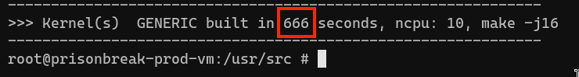

🤘

Slide 39
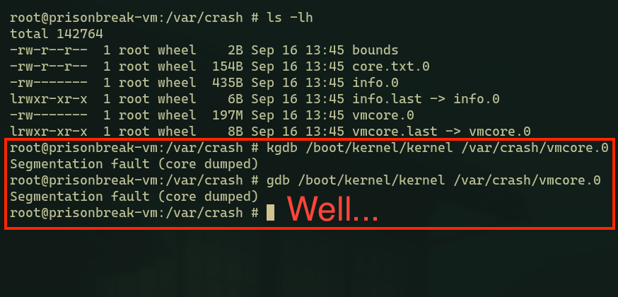
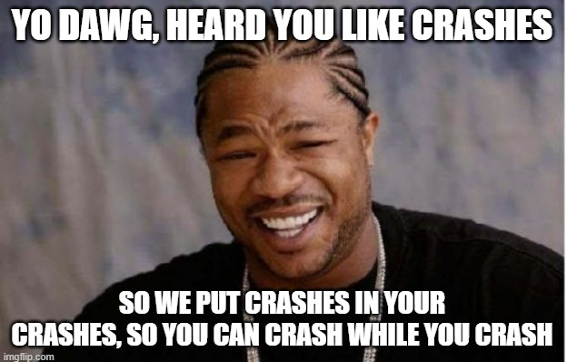
Exploit development environment: debugging
1st attempt: using debug kernel + offline debugging of kernel crash dump

Slide 40
Exploit development environment: debugging
2nd attempt: using debug kernel + online debugging from second VM
Chapter 10 Kernel Debugging of the FreeBSD Developers’ Handbook
Uses serial link => emulate with QEMU over TCP via host machine
Mind your MAC addresses!
Try to understand what you’re doing to avoid rookie mistakes. Case in point: symbols mismatch debacle (issue #58)

Slide 41
Exploit development environment: debugging
3rd attempt: clone target VM from debugger VM
Don’t copy a custom built debug kernel from the target to the debugger and expect symbols to just magically align. Just build a debug kernel and duplicate the QEMU disk image to use as debugger VM.
See VM setup guide in repository

Slide 42
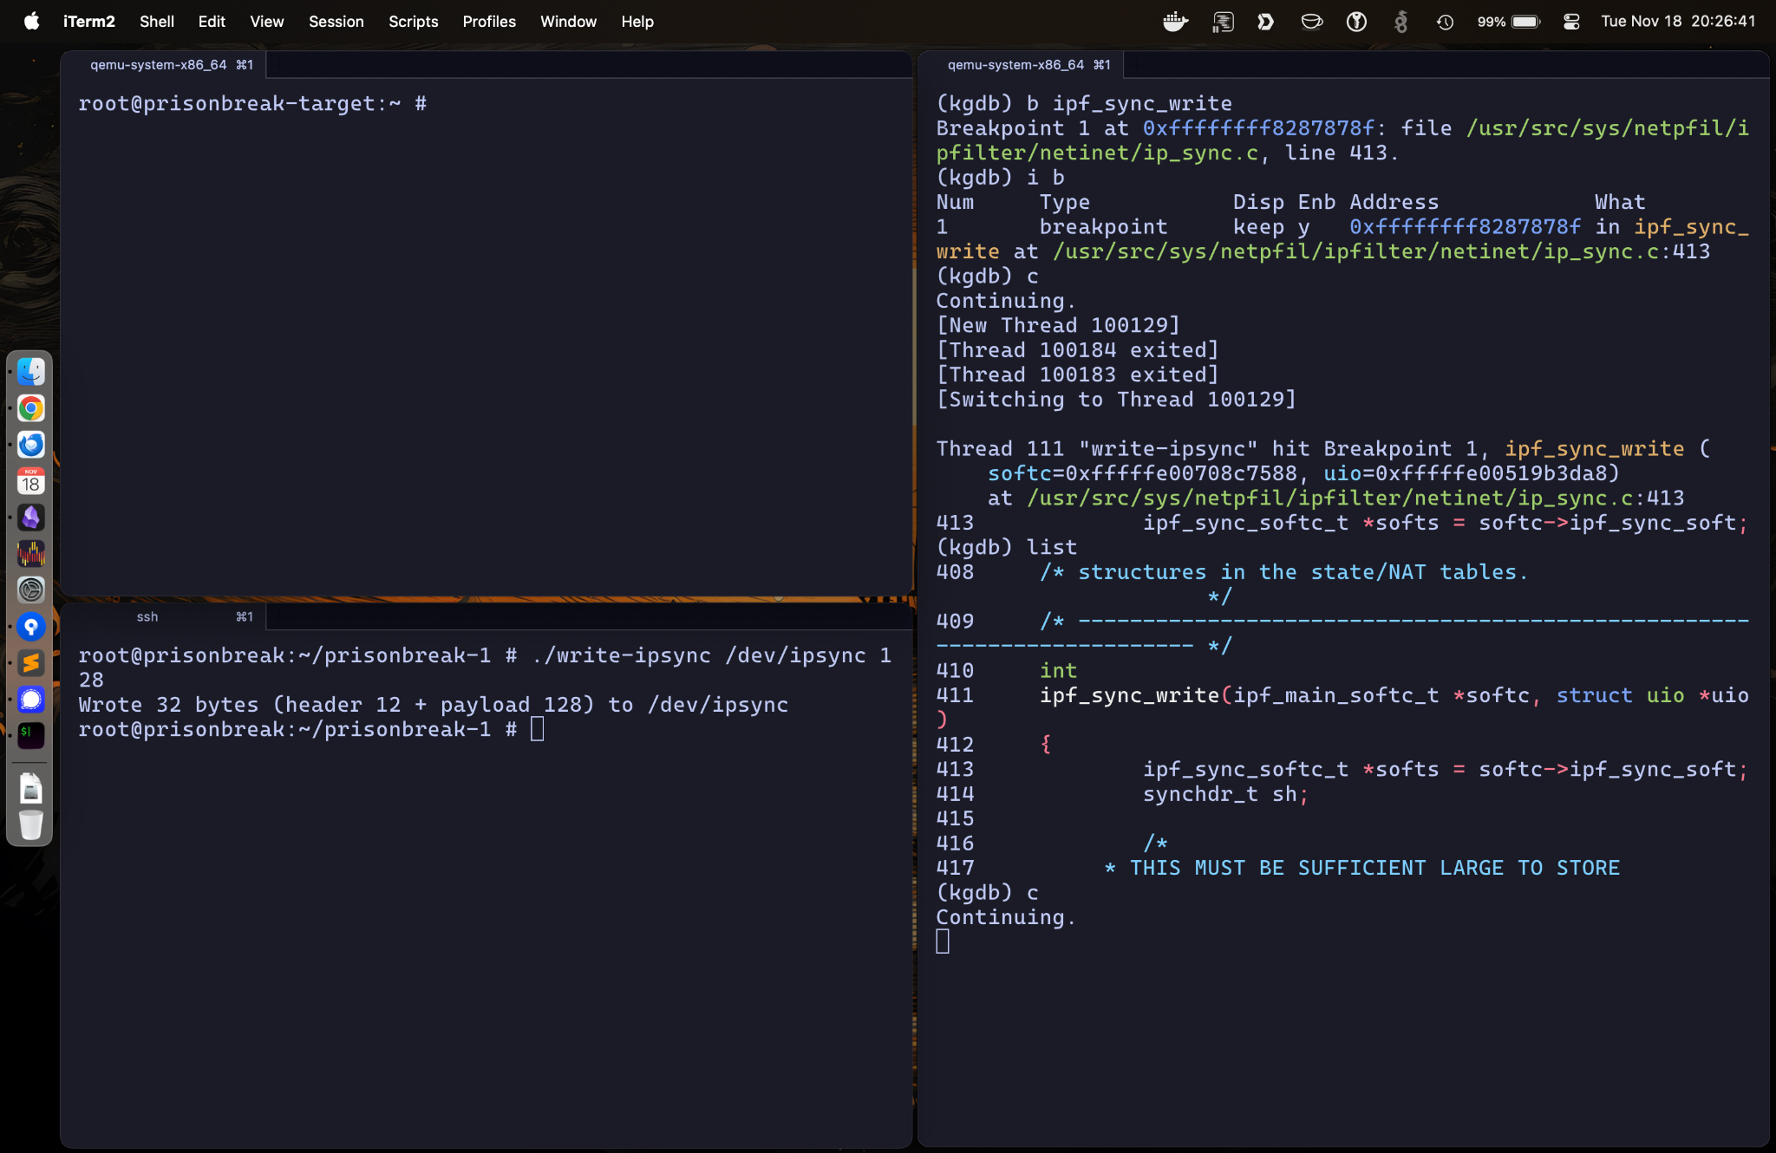

Slide 43
Exploit 1: unbounded malloc() in dummynet (#9)
My first ever kernel exploit 🥳
Crafted setsockopt() call triggers unbounded malloc()
Leads to a kernel panic on low resource machines or when used in a multithreading scenario
Can easily be weaponized as a DoS
Combination of user supplied len value with M_WAITOK type malloc()

Slide 44
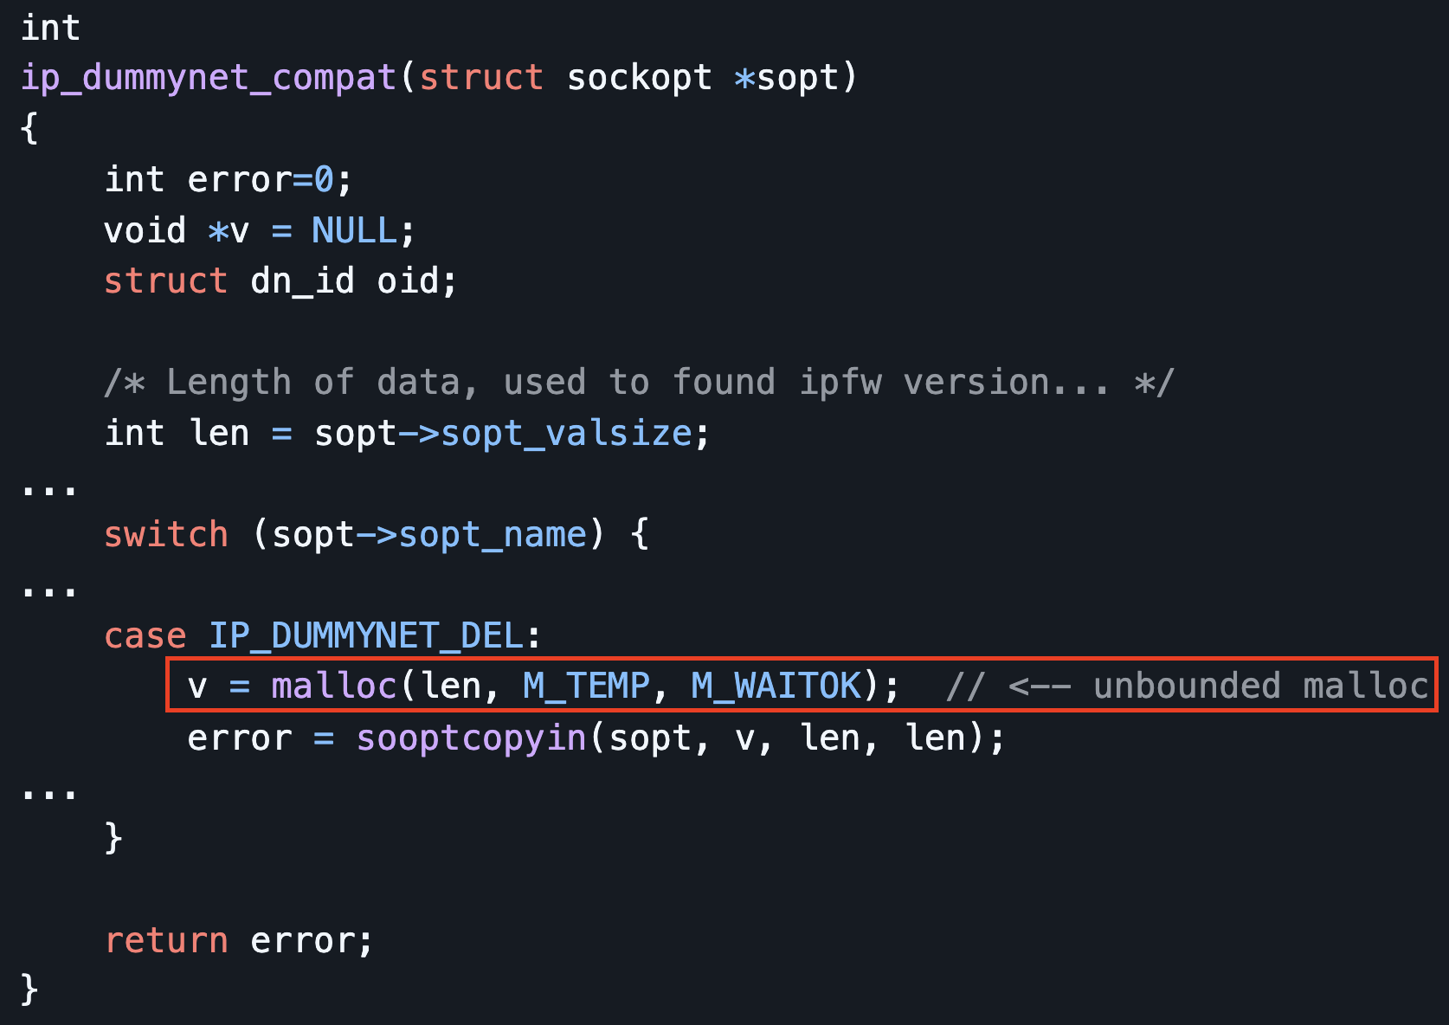
Exploit 1: unbounded malloc() in dummynet (#9)

Slide 45
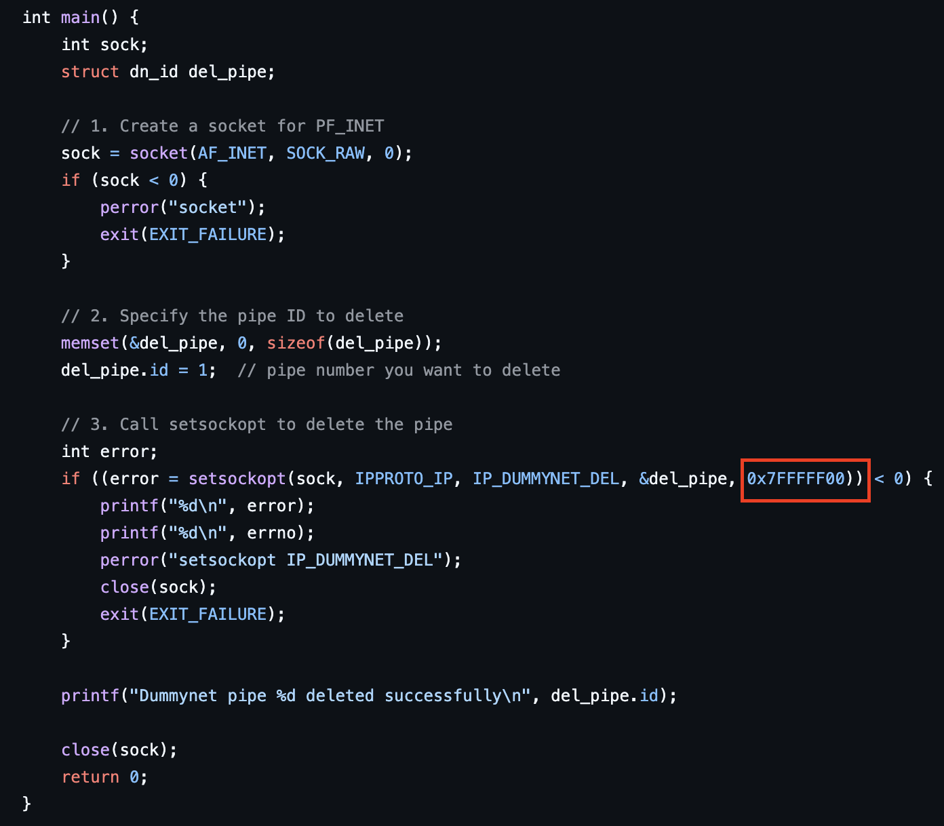
Exploit 1: unbounded malloc() in dummynet (#9)

Slide 46
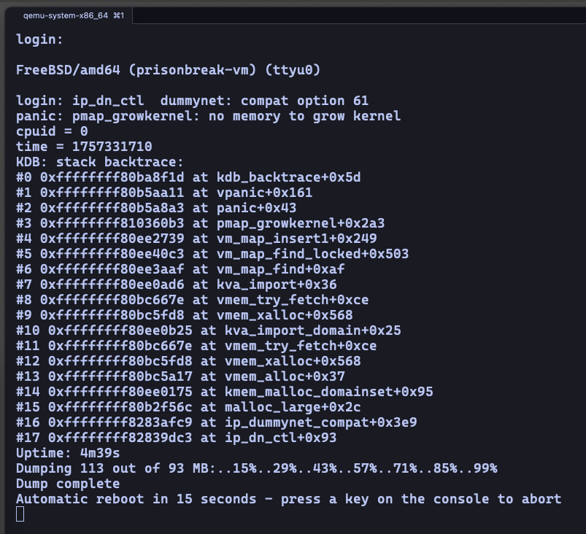
Exploit 1: unbounded malloc() in dummynet (#9)

Slide 47
Exploit 2: unbounded malloc() in IP_FW_TABLE_LIST (#9)
Similar bug to the one used by exploit 1 but leveraging getsockopt() instead of setsockopt()
Can also be easily weaponized as a DoS
Combination of user supplied len value with M_WAITOK type malloc()

Slide 48
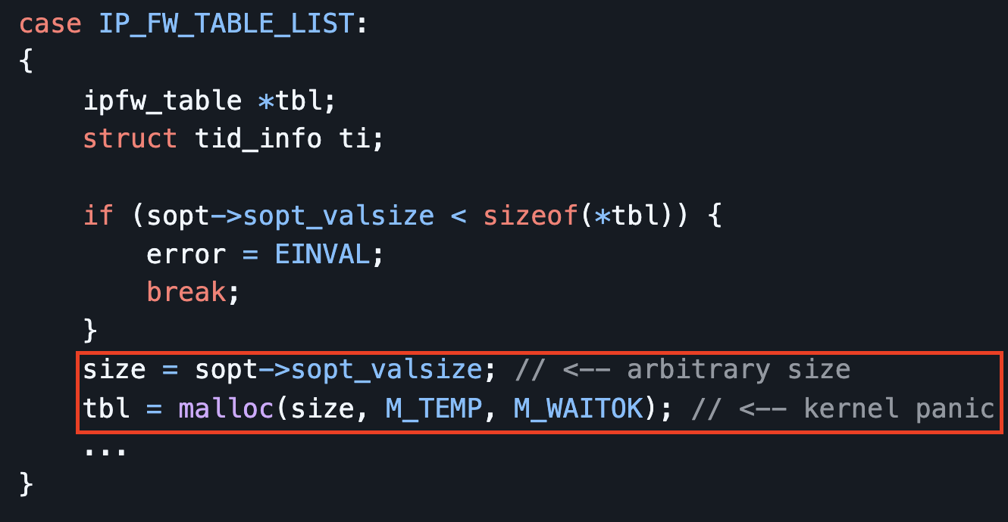
Exploit 2: unbounded malloc() in IP_FW_TABLE_LIST (#9)

Slide 49
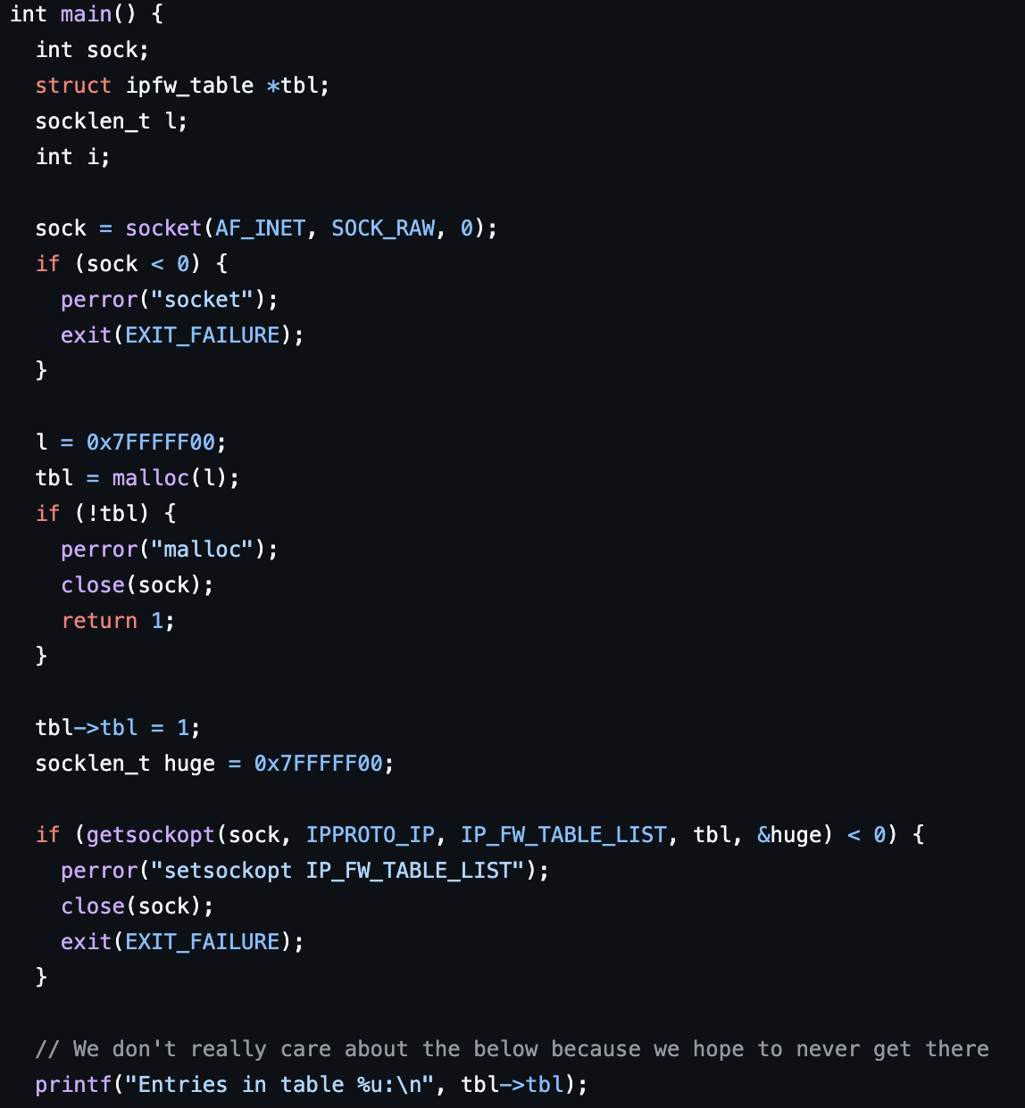
Exploit 2: unbounded malloc() in IP_FW_TABLE_LIST (#9)

Slide 50
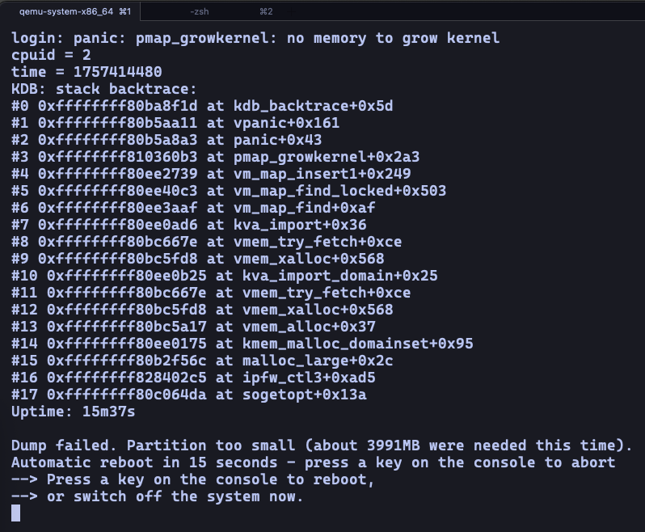
Exploit 2: unbounded malloc() in IP_FW_TABLE_LIST (#9)

Slide 51
Exploit 3: stack buffer overflow in ipf_sync_write()(#13)
Allocation of fixed 2048-byte stack buffer
No validation on user-supplied length
Triggers classic stack smash
Good candidate for taking over code execution flow
Used in comprehensive exploit later on

Slide 52
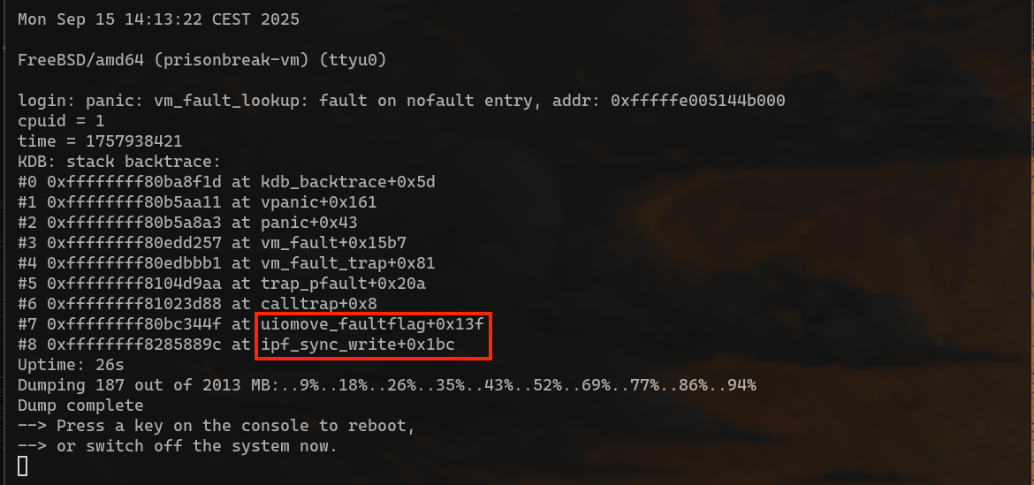
Exploit 3: stack buffer overflow in ipf_sync_write()(#13)

Slide 53
Exploit 4: copyout size mismatch in carp_ioctl_get() (#50)
Attempt to avoid out-of-bounds write, backfires
Causes kernel to unintentionally return more data from memory
Multiple carp interfaces technically not possible by design or because of a subtle locking bug, but can be worked around in code
Can be leveraged to leak the stack cookie (and will be 😎)
Used in comprehensive exploit later on

Slide 54
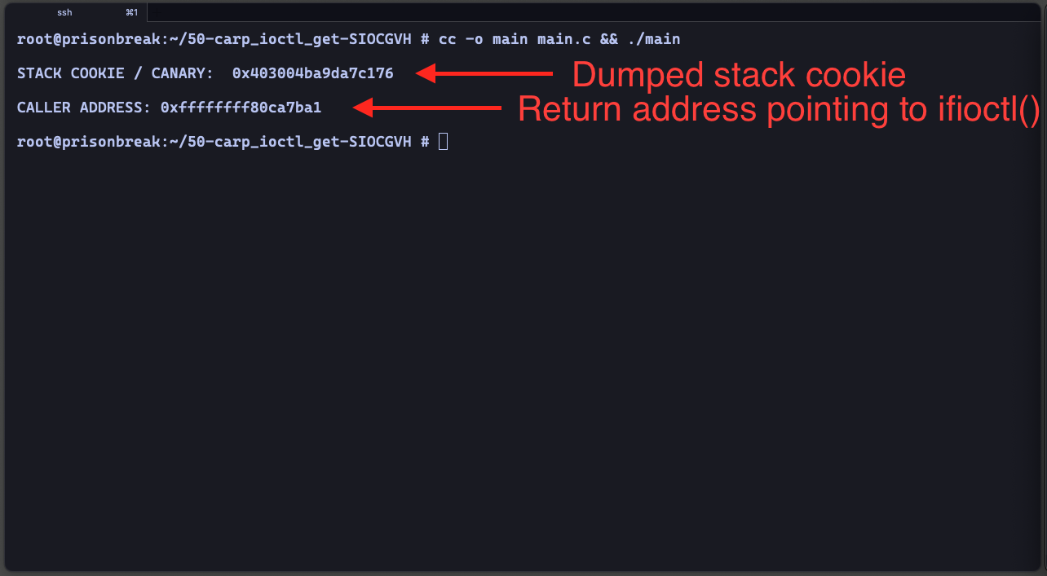
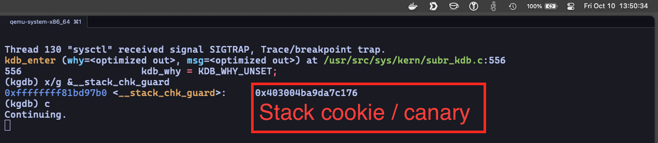
Exploit 4: copyout size mismatch in carp_ioctl_get() (#50)

Slide 55
Exploit 5: comprehensive proof of concept
Goal: full host machine takeover from a compromised jail
Leverages exploitation of multiple bugs
A good proof of concept to show what is possible when (jail) assumptions don’t hold up

Slide 56
Exploit 5: comprehensive proof of concept
Constraints to deal with
Stack protection
Non-executable memory => can’t inject shellcode
SMEP (Supervisor Mode Execution Prevention)
Can’t jump to instructions in userland
SMAP (Supervisor Mode Access Prevention)
Can’t read or write data from/to userland

Slide 57

Exploit 5: comprehensive proof of concept
Stack protection
Enabled by default for the kernel in FreeBSD-8.0-current-200811
Instruction pointer sits behind a stack cookie
Can’t overwrite one without overwriting the other
In the context of linear overflows
Triggers a kernel panic => game over

Slide 58
Exploit 5: comprehensive proof of concept
Stack protection (continued)
Fortunately the kernel stack cookie is a global value set at boot time
Solution
somehow leak the stack cookie value
replace overwritten value during the stack smash
profit
Bug #50 (copyout size mismatch in carp_ioctl_get()), exploit 4
Perfect candidate for leaking the stack cookie from kernel memory

Slide 59
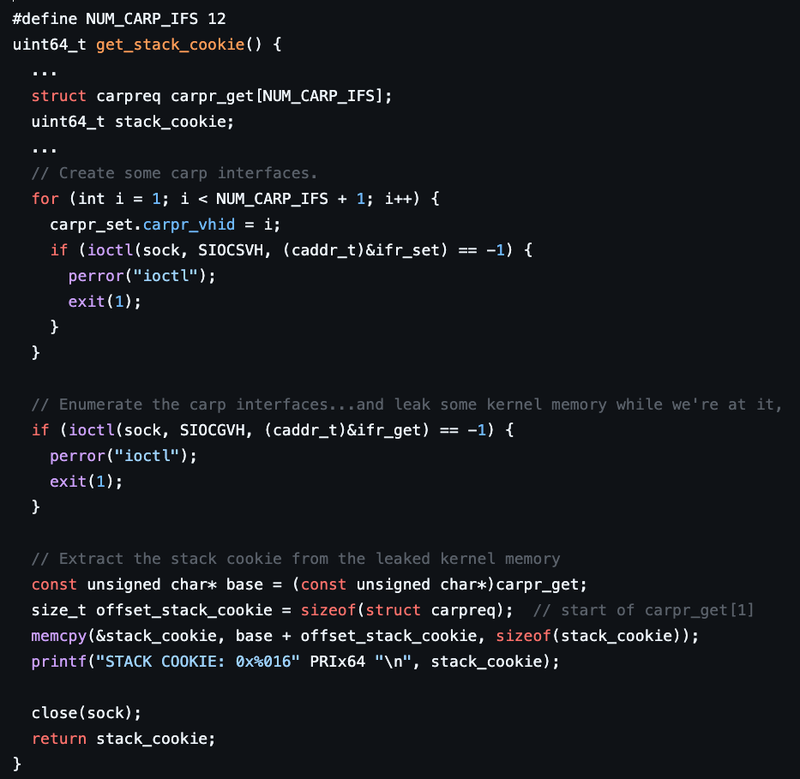

Slide 60
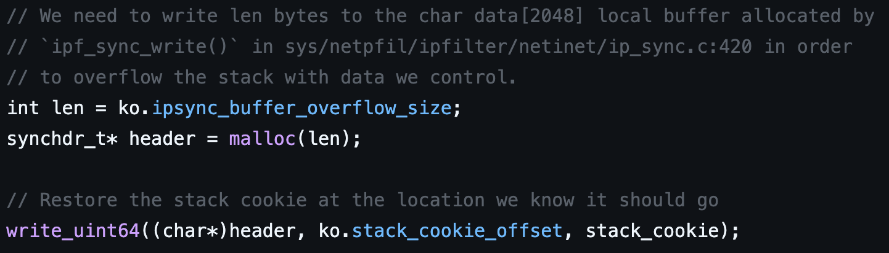

Slide 61

Exploit 5: comprehensive proof of concept
Non-executable kernel memory and SMEP
Can’t inject our own instructions
Non-exec pages
Can’t jump to somewhere useful
In userland
Can jump to kernel functions
kern_kldload() => load our very own kernel module
Continue exploitation and cleanup with C code
Notes:
Mention earlier attempt with linker_load_module() => seemed easier at first glance but not ideal => needed way more arguments and locking
Found address of kern_kldload() with `nm` and `grep` on kernel image => deterministic!

Slide 62
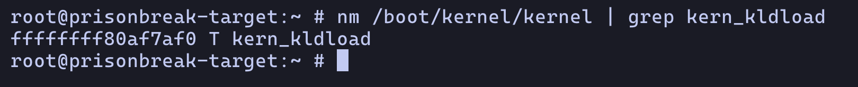
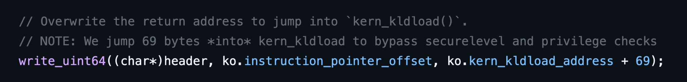

Slide 63
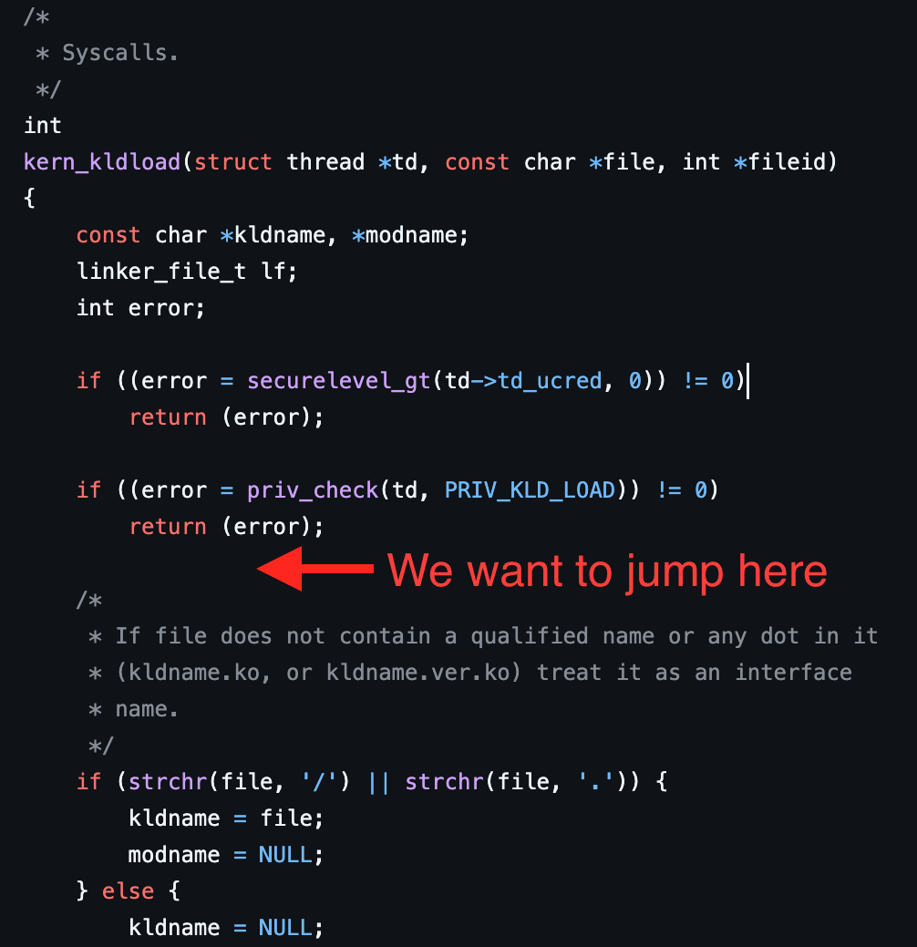
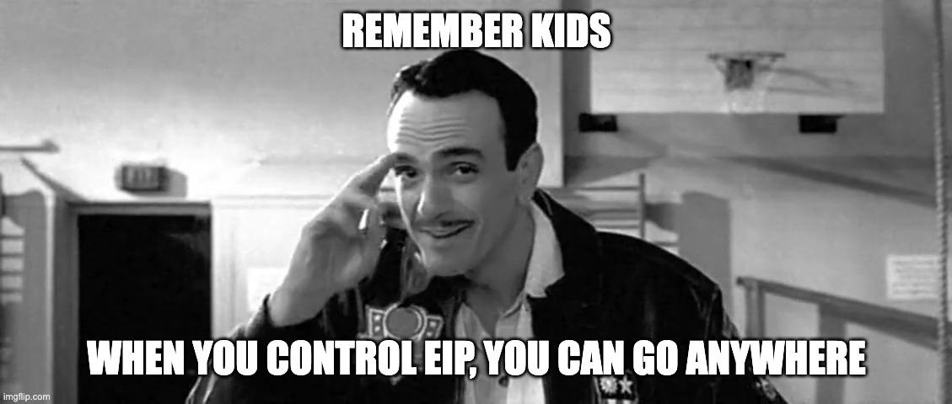
Notes:
Explain why we jump 69 bytes into kern_kldload() => to bypass securelevel and privilege checks

Slide 64
Exploit 5: comprehensive proof of concept
SMAP (Supervisor Mode Access Prevention)
Parameters for kern_kldload()
*td => current thread descriptor
*file => pointer to string containing full path to kernel module binary
*fileid => output parameter of no interest to us and can be NULL

Slide 65
Exploit 5: comprehensive proof of concept
SMAP (continued)
*td argument
Current thread context
Surprisingly easy to get via a userland call to sysctl(KERN_PROC_PID)
Get the value from kp.ki_tdaddr
Put it somewhere in our buffer overflow data
Our stack overflow puts it in kernel memory, right where kern_kldload() expects it => SMAP mischief managed
Found by Ilja in Phrack #60: “Smashing The Kernel Stack For Fun And Profit” by Sinan "noir" Eren from 2002 (https://phrack.org/issues/60/6#article)

Slide 66
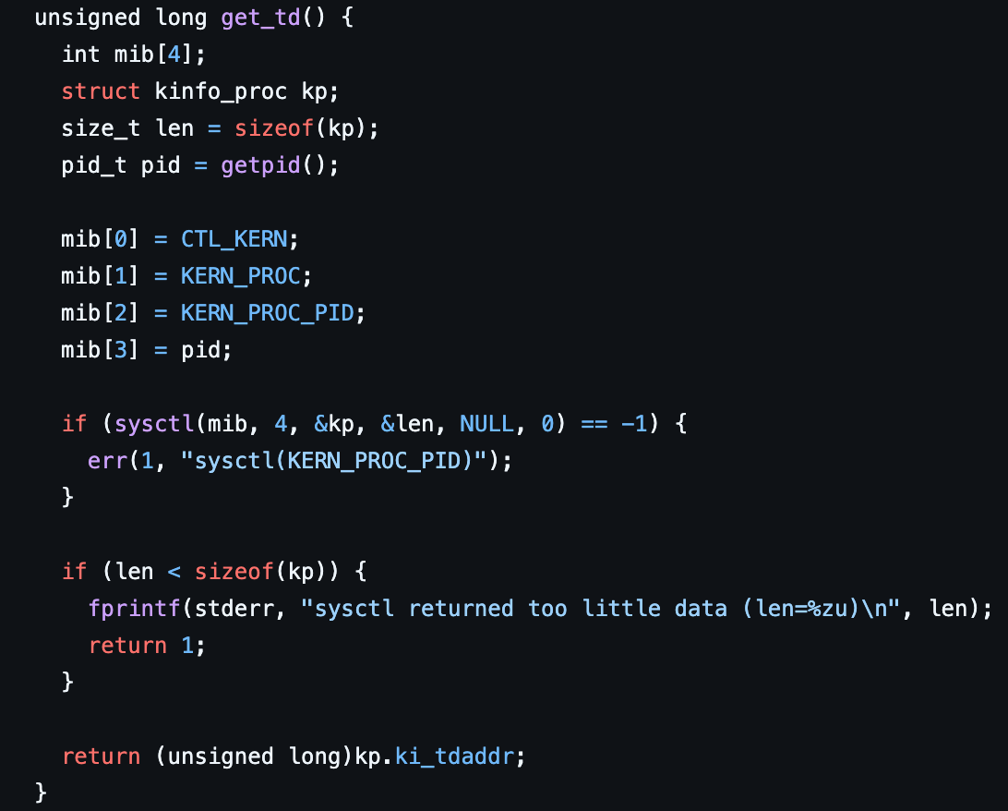

Slide 67
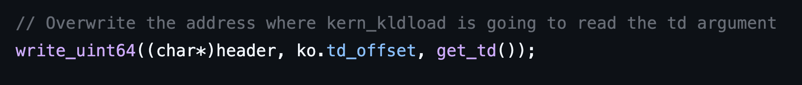

Slide 68
Exploit 5: comprehensive proof of concept
SMAP (continued)
*file argument
Needs to point to string in kernel memory, not userland
We call our good friend sysctl(KERN_PROC_PID)again, this time get the kernel pointer to the arguments passed into the program from the command line
Pass the path to the kernel module string as exploit argument
Call sysctl(KERN_PROC_PID) and get address from kp.ki_args + 50
Put the address somewhere in our buffer overflow data
Our stack overflow puts it in kernel memory, right where kern_kldload() expects it => SMAP once again bypassed

Slide 69
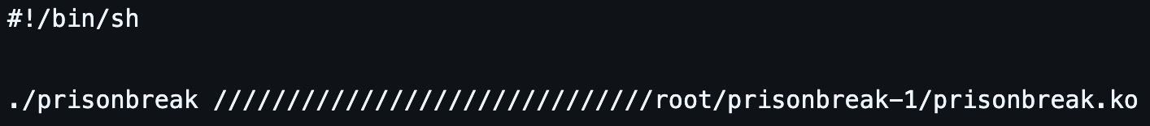

Slide 70
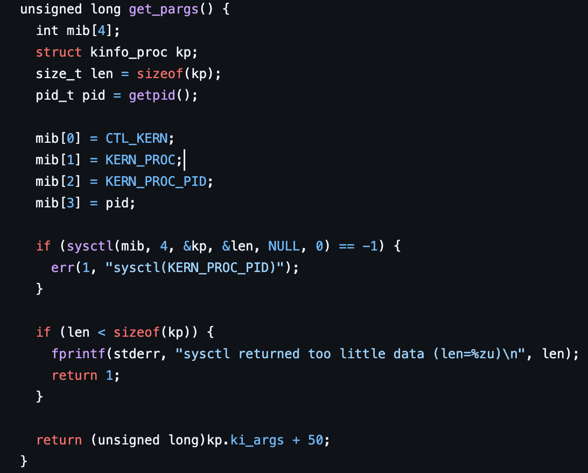

Slide 71
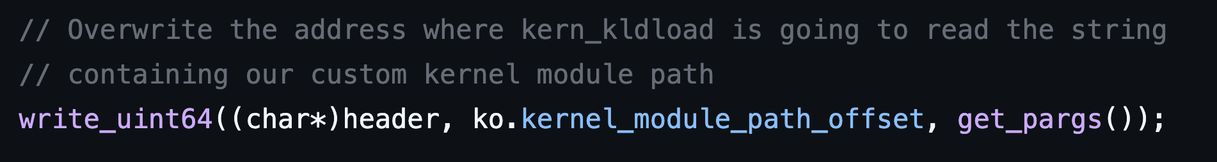

Slide 72
Exploit 5: comprehensive proof of concept
SMAP (continued)
*fileid argument
Output argument of no interest to us and can be NULL
Ensure that location in our overflow buffer contains a 0

Slide 73
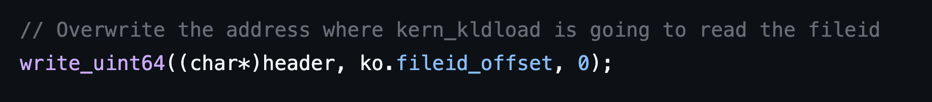

Slide 74
Exploit 5: comprehensive proof of concept
Custom kernel module
Why
Convenience of C code
Full kernel privileges
Clean up mess made by stack smash to make sure we don’t crash
Take total control of host

Slide 75
Exploit 5: comprehensive proof of concept
Custom kernel module (continued)
Tasks
Report progress back to exploit in userland
Escape the jail
Clean up from exploit

Slide 76
Exploit 5: comprehensive proof of concept
Custom kernel module (continued)
Report progress back to exploit in userland
Exploit maps memory in userland
Module establishes access to user memory
Module uses memory to pass messages to userland instead of spilling the beans in the host’s /dev/console
Exploit dispatches messages from module to attacker

Slide 77
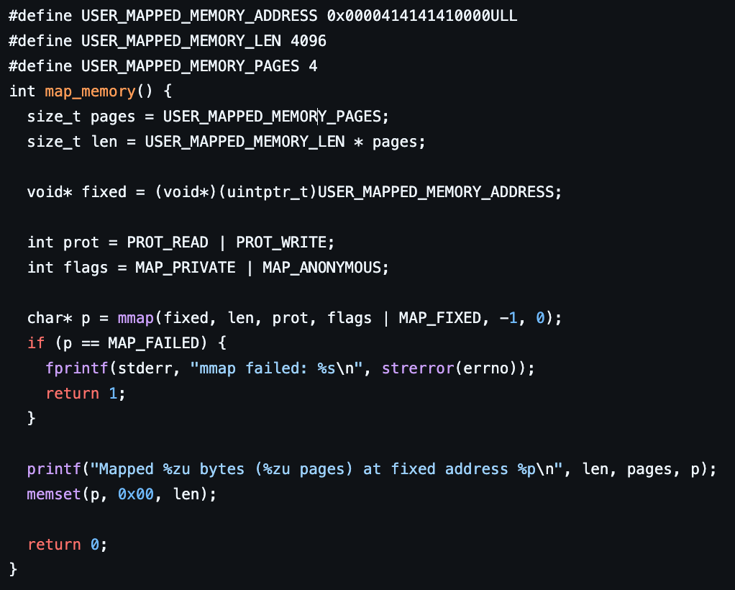
Exploit maps memory in userland

Slide 78
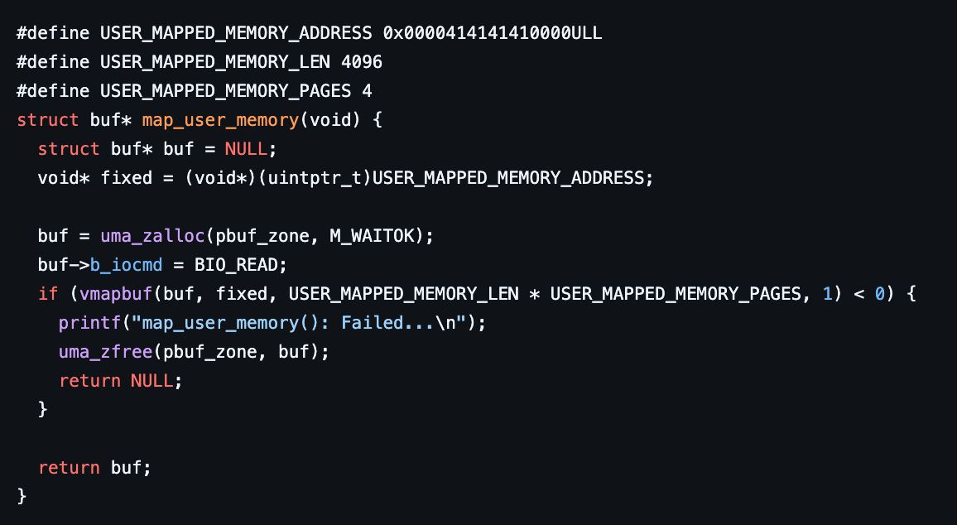
Module establishes access to user memory

Slide 79
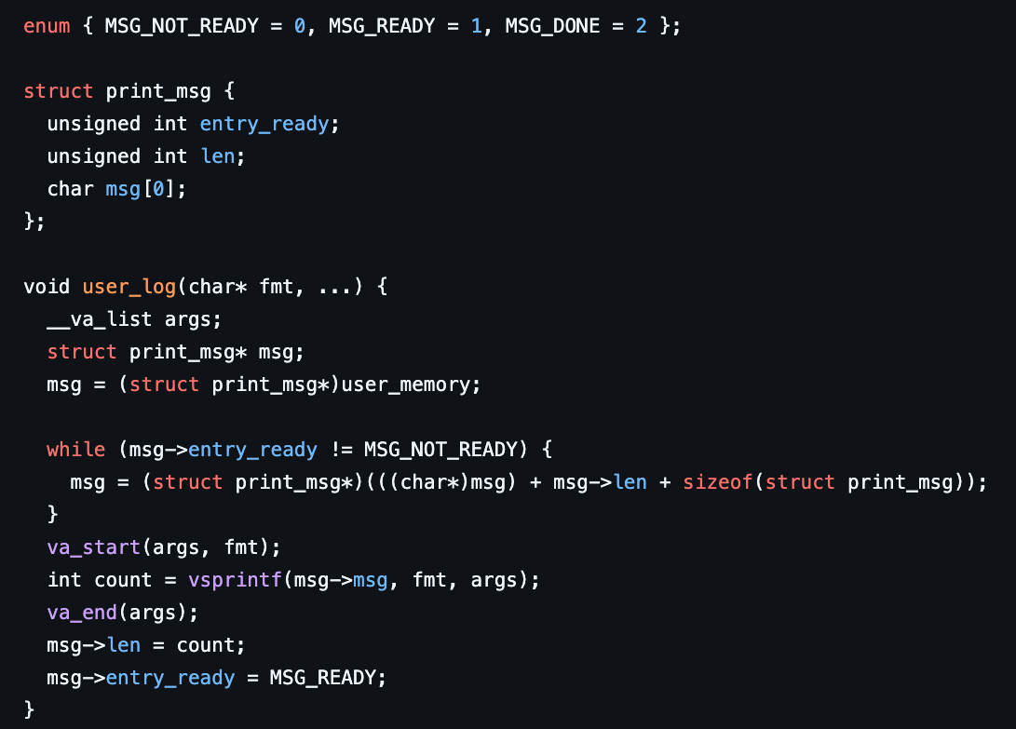
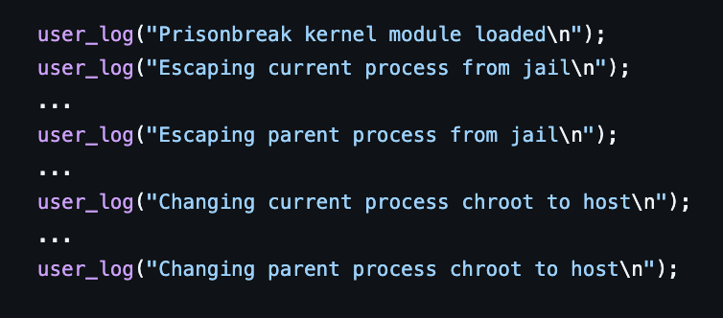
Module uses memory to pass messages to userland

Slide 80
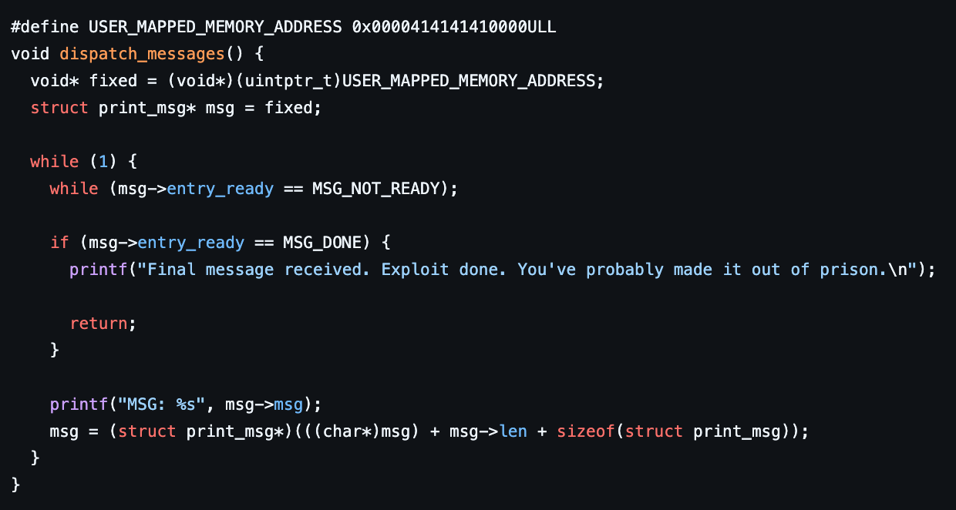
Exploit dispatches messages from module

Slide 81
Exploit 5: comprehensive proof of concept
Custom kernel module (continued)
Escape the jail
Unjail processes
Exploit (current process)
Shell that initiated the exploit (parent process)
Change chroot to host root (/) for current and parent processes

Slide 82
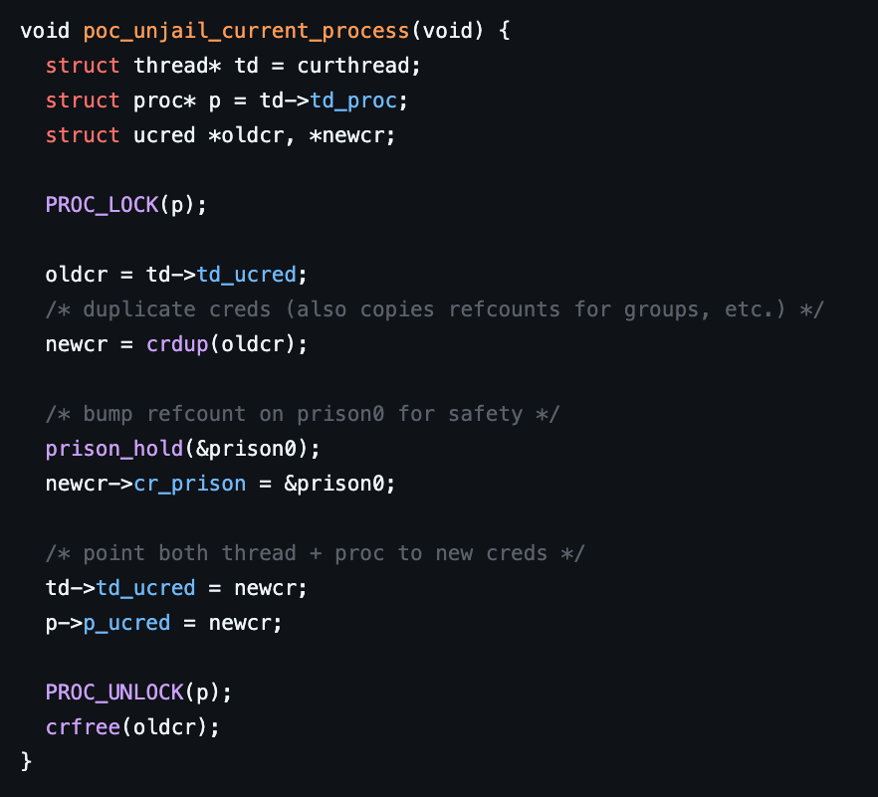
Unjail processes

Slide 83

Change chroot to host root (/)

Slide 84

Exploit 5: comprehensive proof of concept
Custom kernel module (continued)
Clean up from exploit
Notes:
No cleanup => to quote Casey Muratori of Handmade Hero fame: “The operating system will come in and cleanup the mess anyway. Doing it yourself in advance is wasting the user’s time!”

Slide 85
Exploit 5: comprehensive proof of concept
Custom kernel module (continued)
Clean up from exploit
Report to userland exploit that we’re done
Unmap userland memory used for passing messages
Unlock the &Giant (twice, for some reason??)
Take a page from Linux’ book and oops out of here with a thread_exit() because we’re lazy and don’t want to do the cleanup ourselves
Notes:
No cleanup => to quote Casey Muratori of Handmade Hero fame: “The operating system will come in and cleanup the mess anyway. Doing it yourself in advance is wasting the user’s time!”

Slide 86

Report to userland exploit that we’re done

Slide 87


Finish cleanup

Slide 88
Exploit 5: comprehensive proof of concept
Side note: interesting timed panic
Happens ~60 seconds after execution of exploit
Caused by expiration event in ipfw_nat table because our fake header created a (corrupt) entry
Solution => change header CMD from CREATE to UPDATE

Slide 89

Lock order reversal panic in ipf_nat_delete()

Slide 90
Lock order reversal panic in ipf_nat_delete()

Slide 91

Overflow buffer data offsets

Slide 92
Overflow buffer data offsets
We need some useful information copied into our overflow buffer, but don’t know where exactly
Fill the overflow buffer with a cyclic pattern (like Metasploit’s msf-pattern_create())
Give ChatGPT context about the pattern generator function implementation and debug output / register dump and it will happily calculate the offset in the overflow buffer for you 👍
Different FreeBSD versions and kernels
Different offsets
Store them in the exploit and detect platform at runtime

Slide 93

Cyclic pattern generation

Slide 94

ChatGPT calculates the offset

Slide 95

ChatGPT calculates the offset

Slide 96

ChatGPT calculates the offset

Slide 97

Offsets are stored in the exploit

Slide 98


Platform is detected by the exploit at runtime

Slide 99
Demo time scene machine

Slide 100
Observations
Types of issues found
Out of bound reads
Out of bound writes
Stacksmashes
Heap corruption
Integer overflows
Race conditions
Information leaks
Unbounded allocations (leading to panics)
Exploitation was realistic
Exploitation was too easy

Slide 101
Conclusions
Tried and tested doesn't mean secure
Much of this code dates back to the 90s — older code tends to have more trivial bugs
Code written with only root callers in mind was lax about validation — "only root can use this anyway" doesn't hold when jailed root can reach it
The jail threat model wasn't anticipated when many of these subsystems / drivers were written
Exploitation was realistic and too easy
Easy to point and laugh
Reality is, it’s _VERY_ hard to build and maintain an operating system!
We do have some suggestions.

Slide 102
Call to action
More Auditing needed :)
Don’t leak critical kernel pointers
Like
Thread pointer
Proc pointer
Pargs
Used by some real program (procstat, sockstat, netstat, gcore, …)
These programs will need to be modified
Possibly need some new kernel interfaces so these programs still get the data they need
Module loading
Significantly more reliable, powerful and flexible than shellcode
Exploit mitigations
ASLR
Shadow stack / CFI / BTI
Rust
Consider adding support for a memory safe language to (Free)BSD
multi- year effort
Work in stages
Add infra first
Write new code in Rust
Possibly backport older code at some point
No silver bullet
Drastically lowers number of memory related issues

Slide 103
Q & A

